Slide 1


DATA-DRIVEN INSIGHTS INTO BLUE BIKES’ USER BEHAVIOR
Guided by: Prof. Kasun Samarasinghe
Submitted by: Group 5-
Karan Rajnikant Patel
Vartika Joshi
Sayali Kolte
Pardasaradhi Adapa

Slide 2
PART 1

Slide 3

INTRODUCTION
Blue Bikes is a public bicycle sharing system in the Boston area. It serves as a convenient and eco-friendly transportation alternative for thousands of residents and tourists.
With the increase in usage over the years, there is a growing need to understand user behavior and bike usage patterns. This understanding is vital for effective resource allocation, scheduling maintenance, and overall service improvement.

Slide 4


Objective
Data
The objective of this project is two-fold: first, we aim to analyze the usage data to uncover insights about user behavior and bike usage trends. Second, we aim to build predictive models that can help anticipate peak usage times and forecast bike demand.
The dataset used for this project is sourced from Blue Bikes' official website. Blue Bikes maintains a comprehensive collection of system data, which is openly available to the public for analysis and insights.

Slide 5



REAL WORLD PROBLEM AND ROLE OF BIG DATA
Bike Sharing Challenges:
Demand forecasting, resource allocation, and customer satisfaction are primary challenges faced by bike-sharing systems like Blue Bikes.
Role of Big Data:
Big data aids in comprehending user behaviors and usage patterns, enabling effective demand forecasting and resource planning. It powers predictive modeling to anticipate demand and facilitates service improvement strategies by identifying high-traffic stations and popular ride times.

Slide 6
TABLE OF CONTENTS
01
02
03
04
Exploratory Data Analysis
Model Development
Interpretations & Conclusion
Recommendations

Slide 7
01
EXPLORATORY DATA ANALYSIS

Slide 8
Dataset Entries:
The dataset comprises 1,048,575 rows and 14 columns
Data Quality:
Missing Data
The "postal code" column has a significant number of missing values, specifically 110,793 entries.
However, the rest of the dataset columns do not have any missing values.
Duplications
Dataset does not contain any duplicate rows, ensuring the uniqueness of each observation.
Outliers and Suspicious Data
The "tripduration" column exhibits numerous outliers, indicating the presence of
unusually long or short trips compared to the majority of rides.

Slide 9
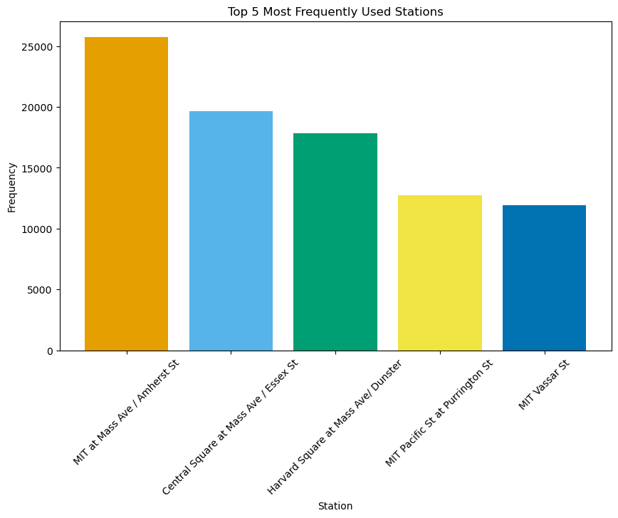
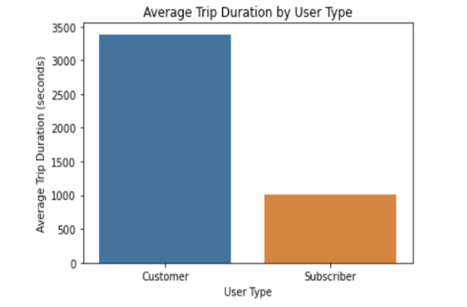
QUESTIONS EXPLORED & INSIGHTS
Top 5 most frequently used stations
Average trip duration for subscribers and customers

Slide 10

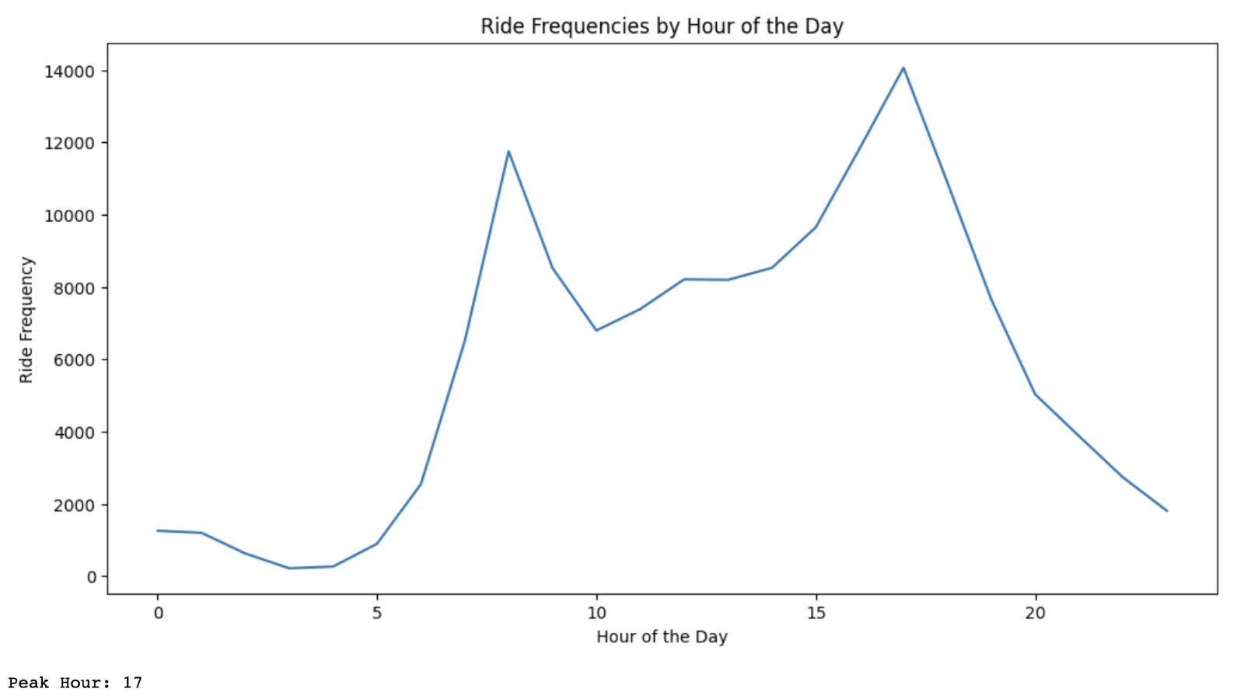
Peak hours of ride frequencies for Blue Bikes

Slide 11
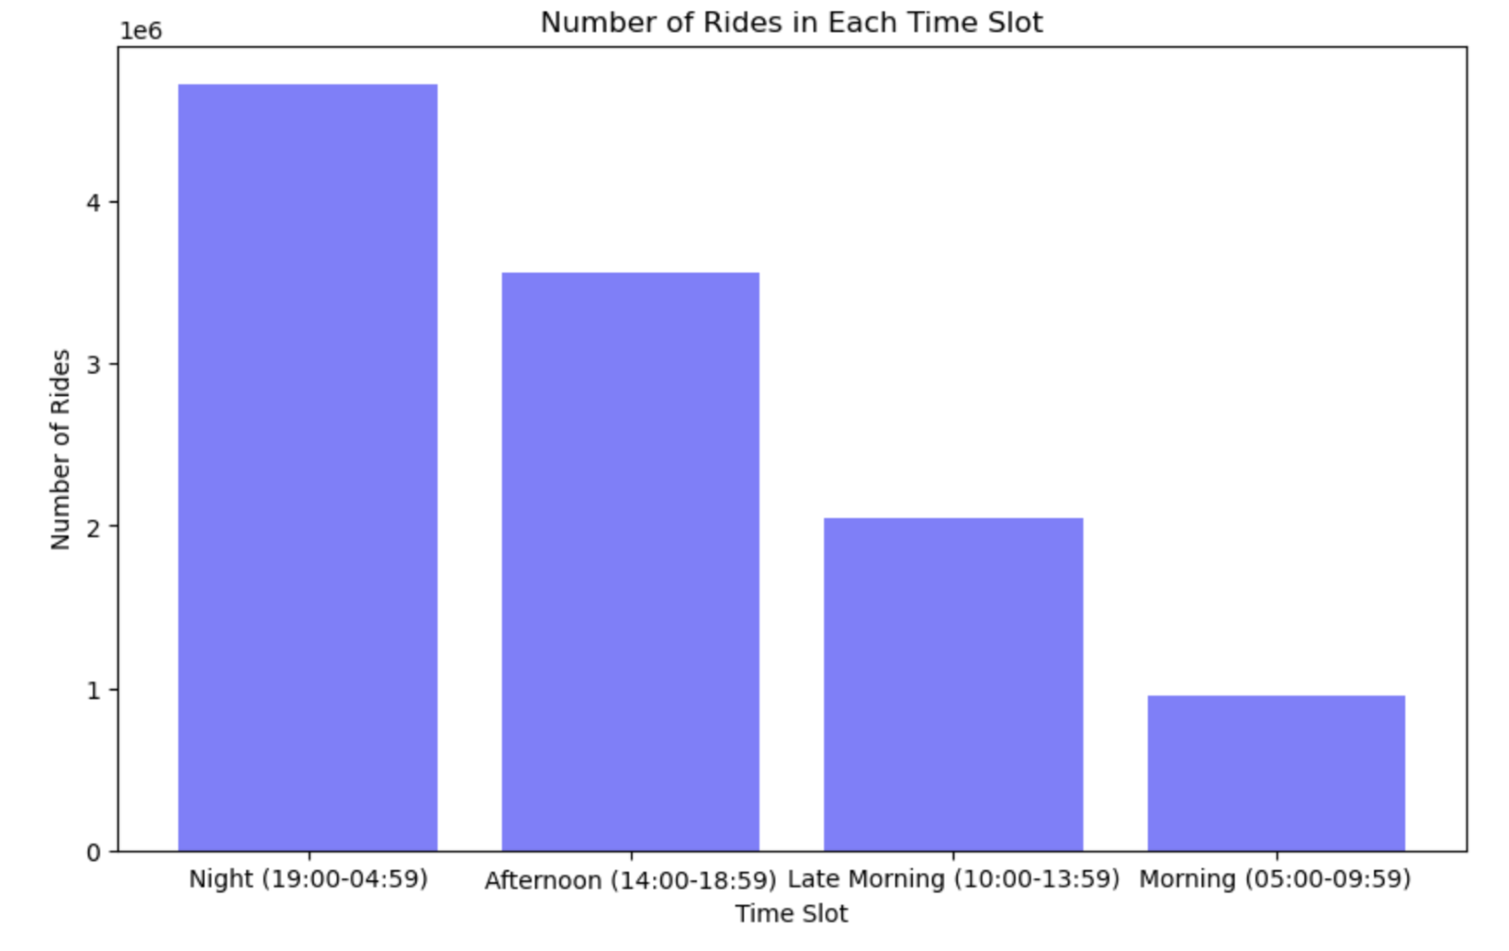
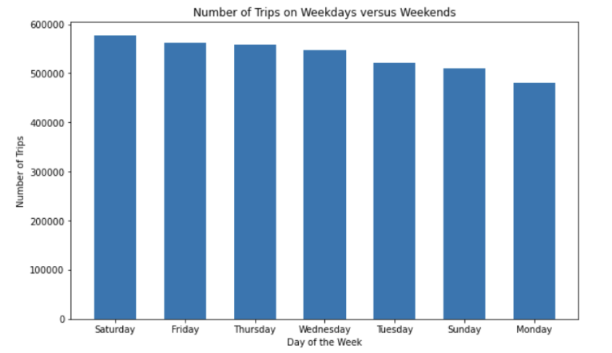
Most popular time slot for bike rides
Usage of blue bikes on weekdays and weekends

Slide 12
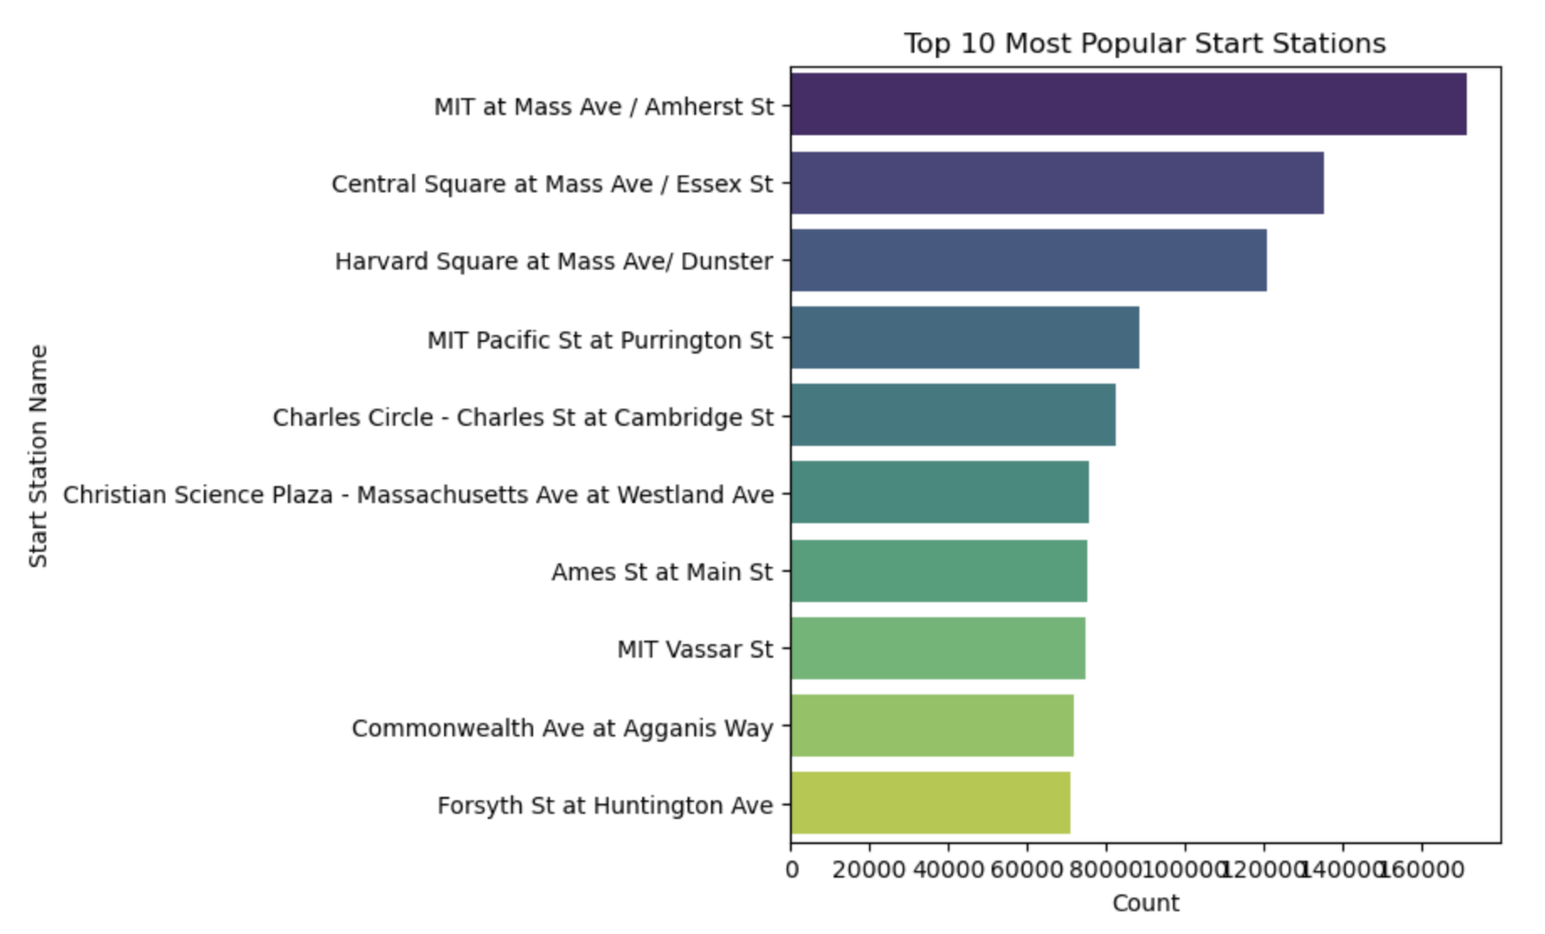
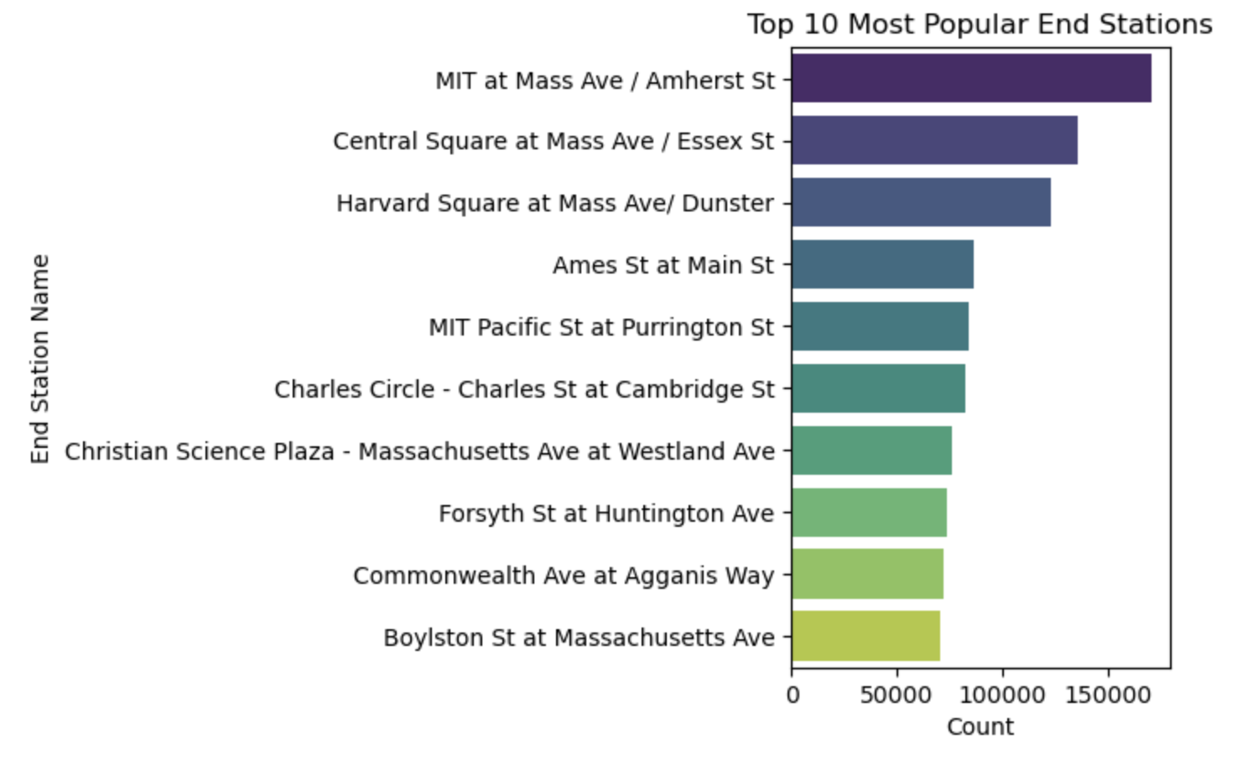
Most popular stations
Popular start stations
Popular end stations

Slide 13
02
MODEL DEVELOPMENT
You can enter a subtitle here if you need it

Slide 14



PREDICTING PEAK HOUR TRIPS
Our task:
Developing a predictive model after the Exploratory Data Analysis (EDA).
The objective:
To utilize various machine learning algorithms to extract useful insights from the data to make accurate predictions.​
Models under examination:
Decision Tree, Random Forest, Gradient Boosting, and Logistic Regression.​​

Slide 15
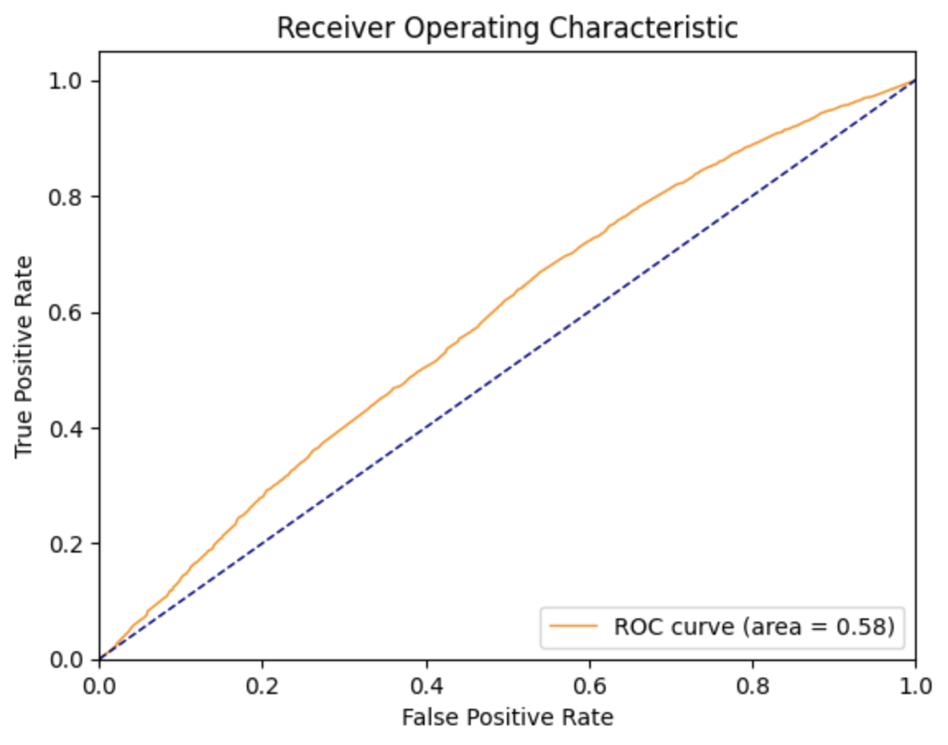
Decision Tree Model
Selected due to its capacity to process both categorical and numerical data, and due to its interpretability.
Used the sklearn library's Decision Tree Classifier for analyzing the dataset.
Initial model accuracy was 57.16%.
Conducted hyperparameter tuning which didn't significantly increase model performance.
The ROC curve analysis indicates that the model's predictions were essentially random.

Slide 16
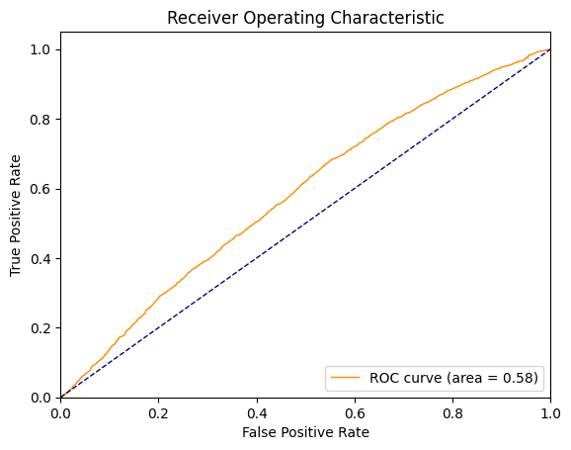
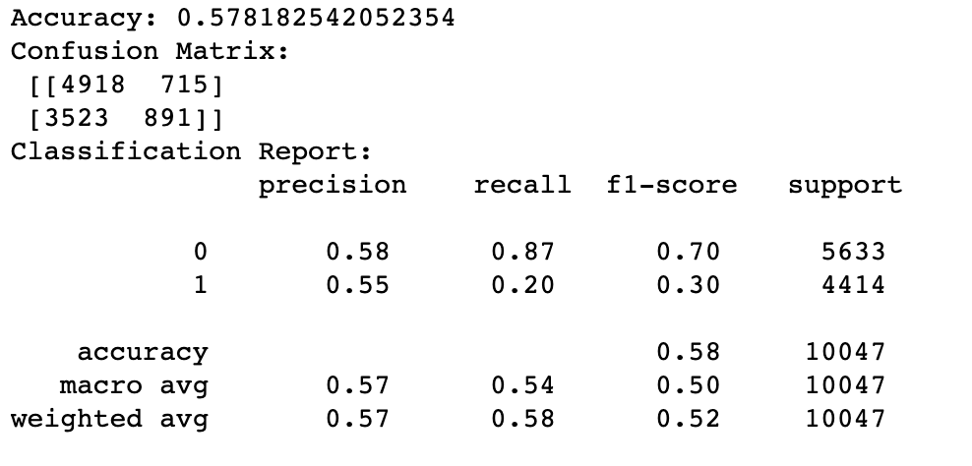
Gradient Boosting Model
This method combines weak predictive models to create a robust ensemble model.
The Gradient Boosting Classifier (GBC) was used for tasks of classification and regression.
Initial model accuracy: 57.81%.
Grid search conducted to identify the best hyperparameters.
The ROC curve and AUC values suggest a moderate level of discrimination ability, with room for performance enhancement.
Processes undertaken include data preprocessing, model training and evaluation, and hyperparameter tuning.
Performance insights were gathered from measures such as accuracy, precision, recall, F1-score, and the confusion matrix.

Slide 17
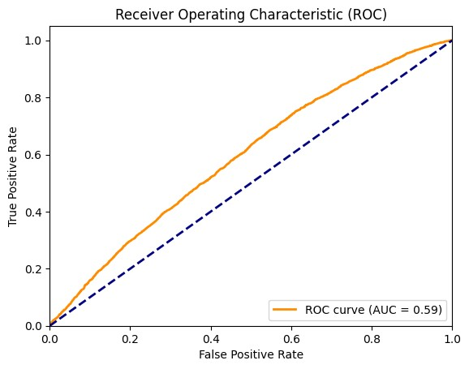
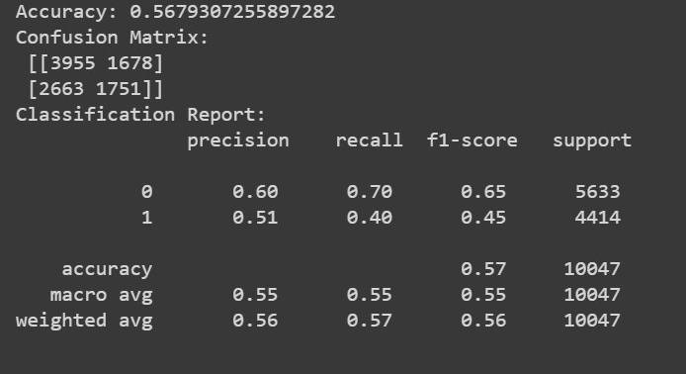
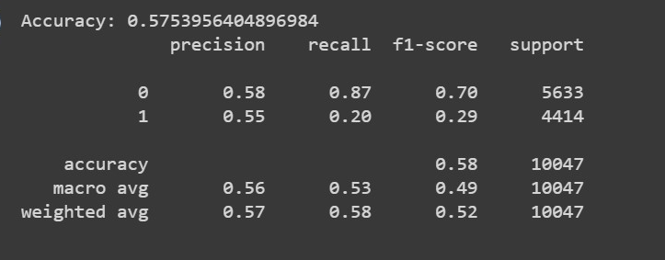
Random Forest Model
Applied the Random Forest algorithm and one-hot encoding for handling categorical variables.
Initial accuracy: 56.8%.
Post hyperparameter tuning, the model showed slight performance improvements, with an accuracy of 57.5%.
The ROC curve depicts the model's capacity to differentiate between rush hour and non-rush hour bike rides.
AUC value of 0.59 indicates moderate discriminatory power.

Slide 18
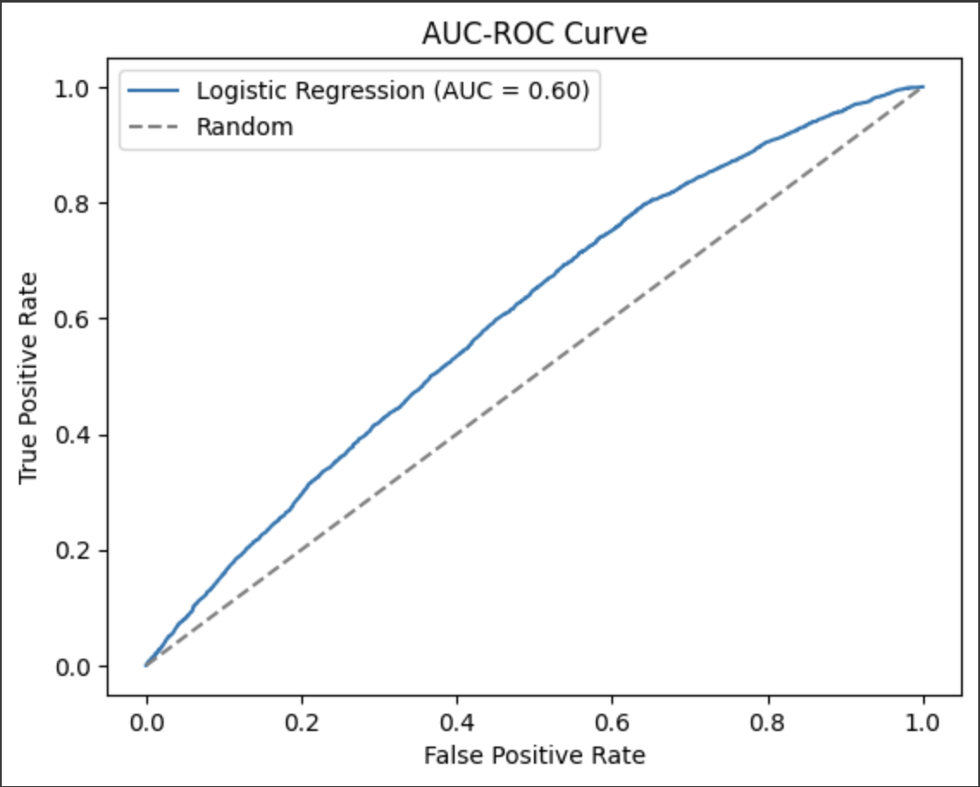
Logistic Regression Model
A Logistic regression model was trained on the training set, yielding an accuracy of 59.09% on the validation set.
Hyperparameter tuning was conducted, resulting in a negligible impact on the model's accuracy.
AUC-ROC score signified a moderate level of discrimination ability.
The AUC value is 0.602, marginally above the line of randomness.

Slide 19
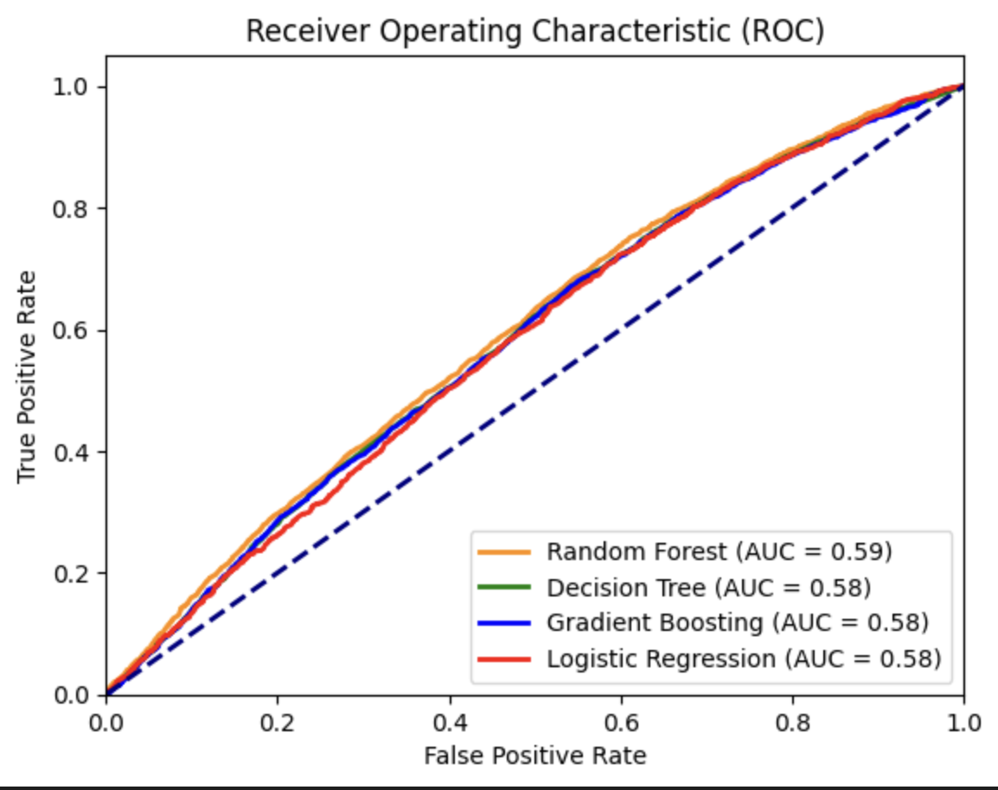
Comparison of ROC Curve
AUC score between 0.58 and 0.59 indicates that the models have some ability to discriminate between rush hour and non-rush hour bike trips, but there is room for improvement.

Slide 20
INTERPRETATIONS
03

Slide 21

INTERPRETATIONS
Predicting peak hour bike trips based on provided attributes is challenging.
Models demonstrated modest predictive performance, with accuracies ranging from 56.8% to 59.09%.
Additional data or advanced modeling techniques may be required for better predictions.
Logistic Regression emerged as the most accurate model, making it the preferred choice.
Enhance resource allocation and improve services for Blue Bikes users.
Improve operational efficiency and customer satisfaction.

Slide 22
RECOMMENDATIONS
Address Missing Data: Ensure consistent capture of "postal code" data to gain further insights into user locations and travel patterns.
Focus on High-Demand Stations and Time Slots: Improve infrastructure and service at most frequently used stations and during peak usage hours.
Investigate Outliers: Conduct a detailed examination of outliers in "trip duration" to identify possible reasons behind unusual trip durations.
Include More Features: Incorporate additional features like weather conditions, public events, or specific calendar days (holidays, weekends, etc.) that might impact bike usage.
Enhance Feature Engineering: Extract new information from existing variables. For instance, transform "start_time" and "end_time" into parts of the day (morning, afternoon, evening, and night).
Address Class Imbalance: Usage of techniques such as oversampling, undersampling, or SMOTE to handle class imbalance issue seen in confusion matrices.

Slide 23
04
CONCLUSION

Slide 24
CONCLUSION
EDA revealed valuable insights into bike usage patterns, such as popular times, days, and locations for bike usage.
All models performed moderately well in predicting peak hour trips, with AUC scores between 0.58 and 0.59.
The models provide a good starting point, but enhancements are required to improve predictive performance.
Implementing the above recommendations could help increase model performance and enable more effective decision-making and strategic planning for the Boston Bluebike system.

Slide 25
PART 2

Slide 26

Bluebikes Data Analysis (Q1 2023)
This report provides a comprehensive overview of the Bluebikes trip data for the first quarter of 2023. The objective is to derive insights about how people use bicycles in Boston and to understand patterns in the data that might be valuable for the business or users.

Slide 27
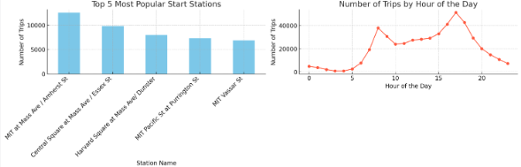
Most Popular Stations
The most popular station for both starting and ending trips is MIT at Mass Ave / Amherst St.

Slide 28

Busiest Times
The busiest hour for bicycle trips is 17:00 (5 PM) and the busiest day of the month is the 3rd.

Slide 29

Machine Learning Insights
A linear regression model was built to predict trip duration based on features like start station, end station, user type, and start hour. The model performance indicated that more advanced models or additional features might be needed for improved predictions.

Slide 30
Clustering Stations
Stations were clustered based on their usage patterns. The clusters provide insights into which stations have similar trip counts, aiding in decision-making for resource allocation, marketing, and maintenance.

Slide 31

Recommendations & Future Work
Recommendations include targeted resource allocation based on station clusters, tailored marketing campaigns, and exploring advanced prediction models. Future work can involve temporal analysis, spatial analysis, and user behavior studies.

Slide 32


LIBRARIES AND TECHNIQUE USED FOR THE ANALYSIS
PYTHON LIBRARIES
Pandas
NumPy
Matplotlib and Seaborn
Scikit-learn:
SciPy
TECHNIQUE
Data Cleaning
Data Preprocessing
Exploratory Data Analysis (EDA)
Predictive Modeling
Model Evaluation

Slide 33
REFERENCES
[1] Blue Bikes Boston. (n.d.). https://www.bluebikes.com/blog/the-data-challenge-entries
[2] Bluebikes. Wikipedia. (2023, June 17). https://en.wikipedia.org/wiki/Bluebikes
[3] Motivate International, Inc. (n.d.). Bluebikes System Data. Blue Bikes Boston. https://www.bluebikes.com/system-data

Slide 34

THANK
YOU

